Slide 1
Introduction to Deep Networks
Part 3

Slide 2
Deep (Learning) Neural Networks – Principles
Some classes of problems are difficult to solve by classical programming.
e.g. Recognizing objects, understanding concepts, comprehending speech.
Human brains can do this easily, but we do not exactly know how they do it. And even if we did, a classical program might be horrendously complicated.
So instead ‘writing a program’, we use a technique where a computer can look at hundreds or thousands of examples and the correct answers
This technique then lets the computer use that experience to solve the same problem in new situations.
Essentially, the goal is to teach the computer to solve by example.
This is very similar to how we might teach a human brain (of a young child) to distinguish a cat from a dog
In traditional machine learning, data scientists or programmers need to identify and extract features which is a complicated ‘art’. Deep Learning can circumvent this requirement.

Slide 3

Deep Neural Networks – Vision Example

Slide 4
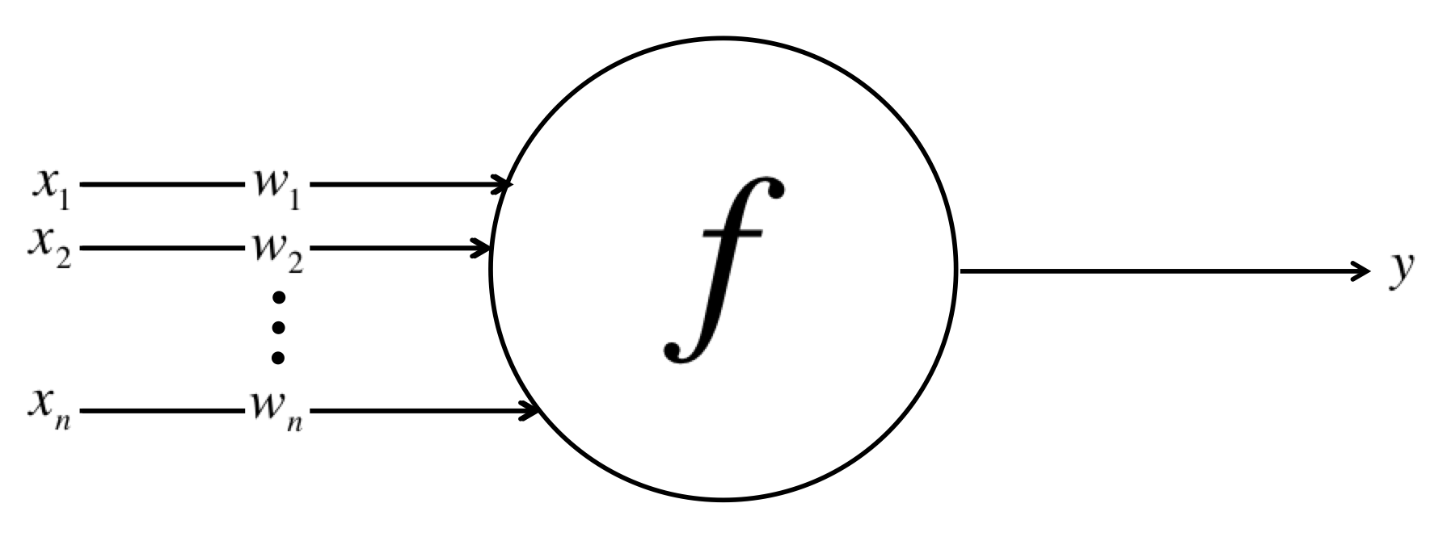
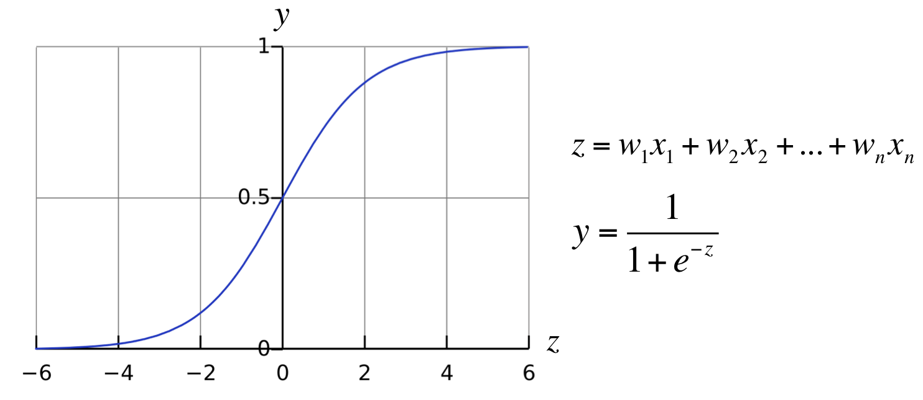
Deep (Learning) Neural Networks – Principles
Since we want to emulate a human brain, we emulate its structure – specifically neurons.
A single neuron is quite simple:
y = f ([w],[x]) where w are the weights
A sigmoidal neuron example:
Y → 0 when Z is large Negative
Y → 1 when Z is large Positive

Slide 5
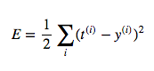
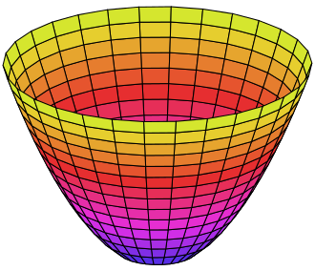
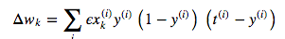
Deep (Learning) Neural Networks – Principles
For a 2-neuron system, if y(i) is the calculated result and t(i) is the known answer, the mean square error would be:
In this case the variation of error w.r.to weights would be a
3-dimensional space
We want to find the weights that minimizes the error (the bottom of the bowl)
We can show mathematically that in this case the weights can be updates as: where ϵ is the learning rate
Since all entities above are known, we can update the weights
This can get much more complicated for more neurons and multiple layers but the basic concepts remain the same

Slide 6
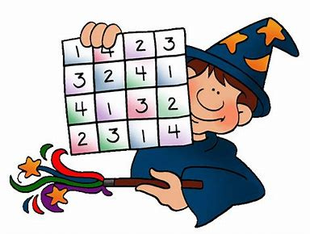


Deep (Learning) Neural Networks – Principles
For some of you this may be easy math
And others may be
Fear not:
Whether you are a math wiz, or not, this work is done for you and libraries like Tensorflow, Keras help you become a Deep Learning Wiz!

Slide 7
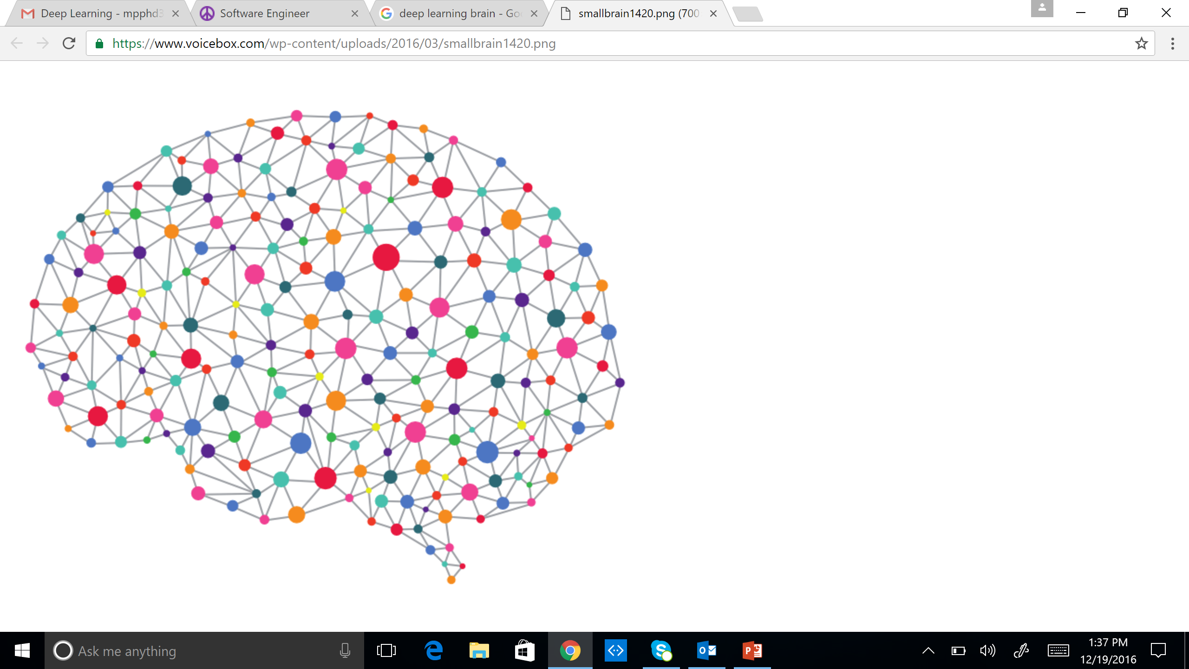
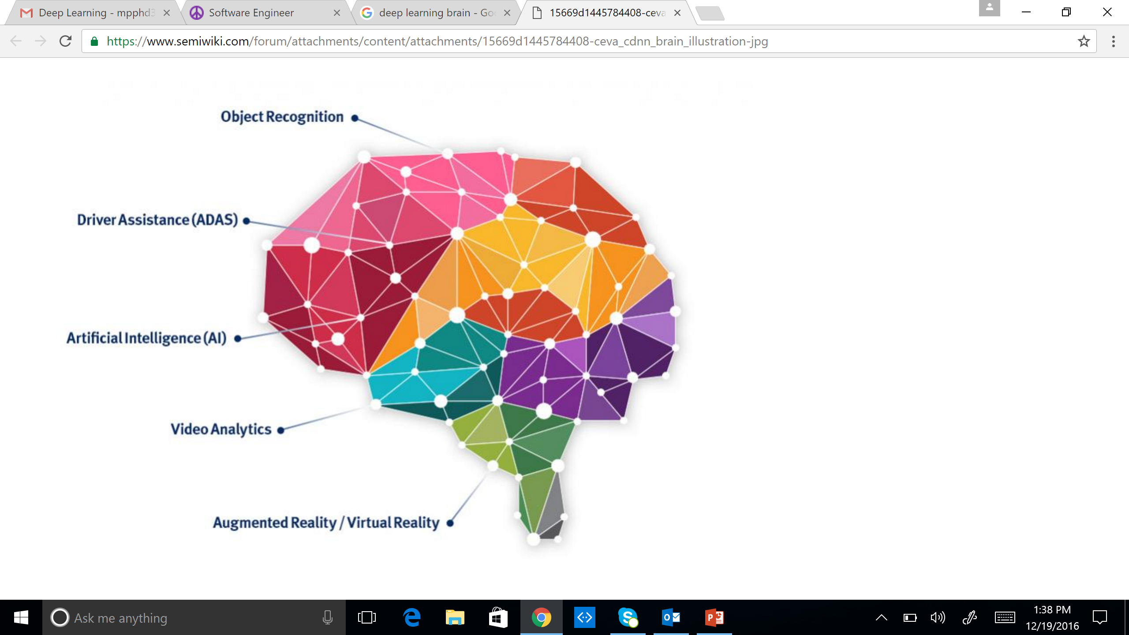
Multiple Layers Make Sense
Deep Learning = Brain “inspired”
Audio / Visual Cortex has multiple stages = Hierarchical

Slide 8
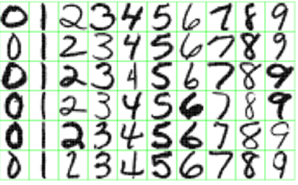
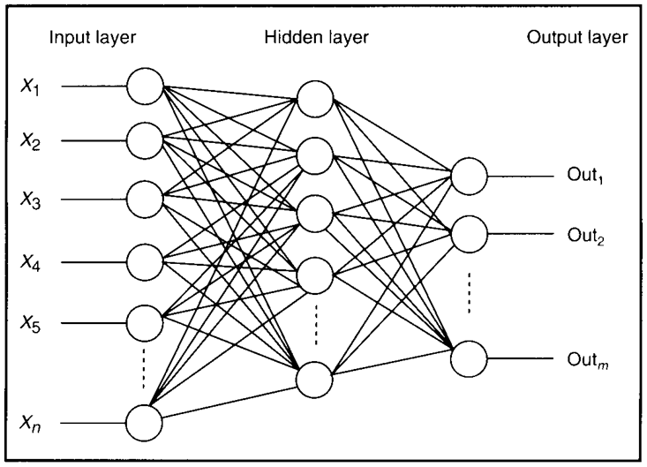
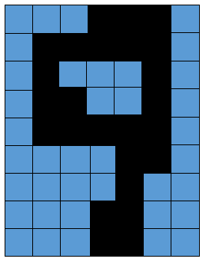
Feature Detectors

Slide 9
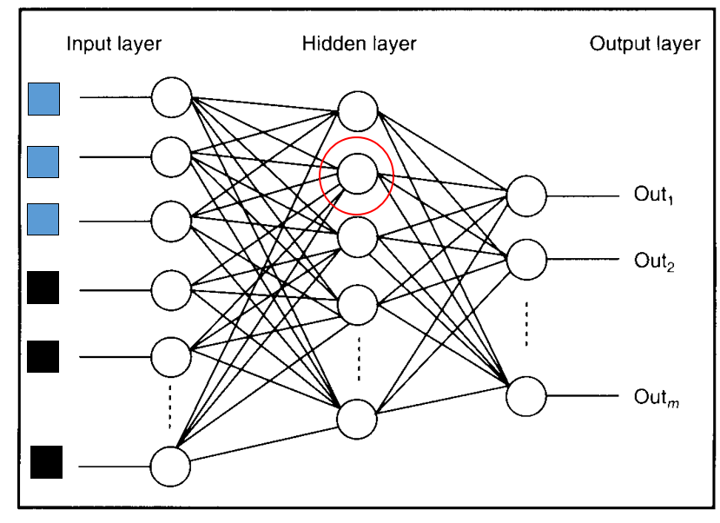
What Is This Unit (Neuron) Doing?

Slide 10
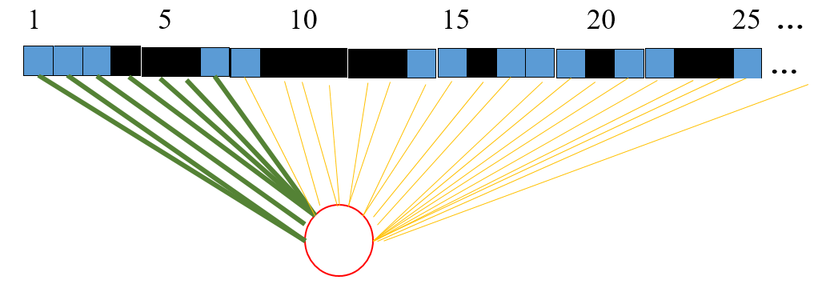
Hidden Layer Units Become Self-Organised Feature Detectors

Slide 11
What Does This Unit Detect?
strong +ve weight
low/zero weight
Strong signal for a horizontal line in the top row,
ignoring everywhere else

Slide 12
What features might you expect a good NN
to learn, when trained with data like this?

Slide 13
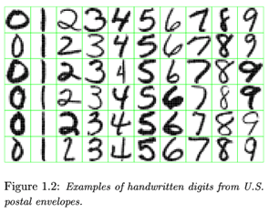
vertical lines

Slide 14
Horizontal lines
63

Slide 15
Small circles
63

Slide 16
Small circles
But what about position invariance ???
our example unit detectors were tied to
specific parts of the image
63

Slide 17
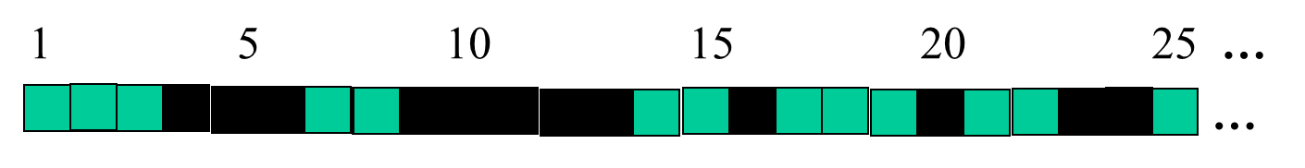
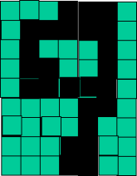
Successive Layers Can Learn Higher-Level Features
Detect lines in specific positions
etc …
Higher level detectors
( horizontal line,
“RHS vertical line”
“upper loop”, etc…
etc …
v

Slide 18
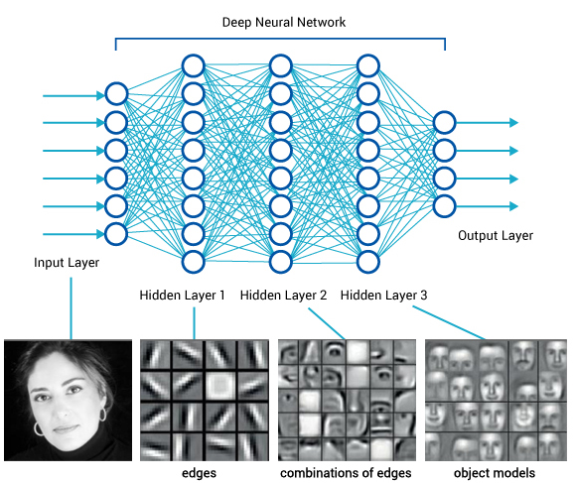
A more complex example

Slide 19
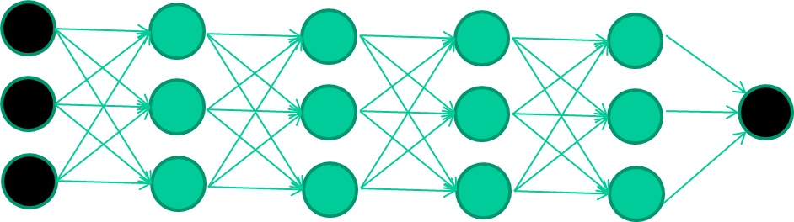
Multiple Layers Make Sense
Many-layer neural network architectures should be capable of learning the true underlying features and ‘feature logic’, and therefore generalise very well …

Slide 20
The New Way To Train Multi-Layer NNs…
Each layer can be thought of as a set of features

Slide 21
Common DNNs
Deep Convolutional Neural Network (DCNN)
To extract representation from images
Recurrent Neural Network (RNN)
To extract representation from sequential data
Deep Belief Neural Network (DBN)
To extract hierarchical representation from a dataset
Deep Reinforcement Learning (DQN)
To prescribe how agents should act in an environment in order to maximize future cumulative reward (e.g., a game score)

Slide 22
Deep Learning And Computer Vision

Slide 23
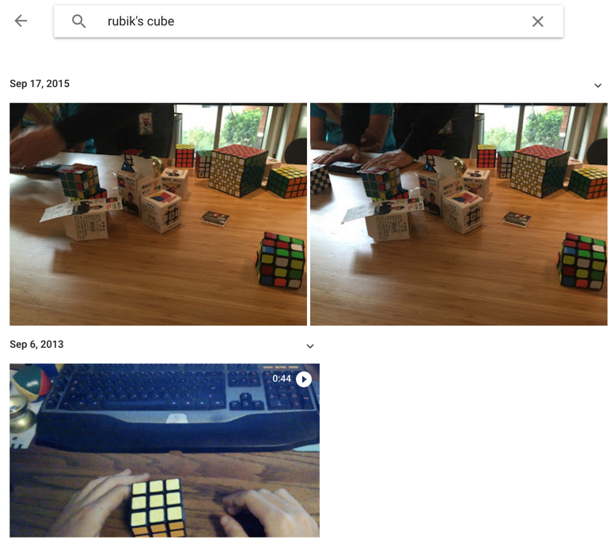
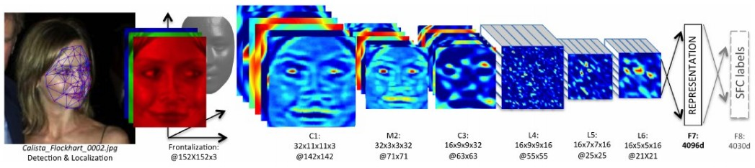
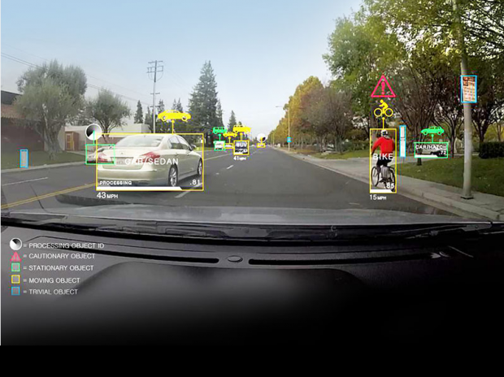
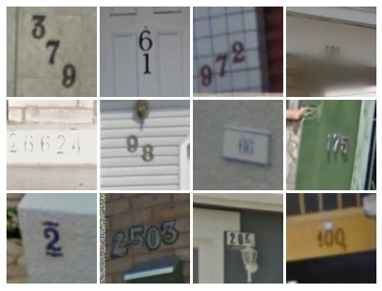
ConvNet
Face Verification, Taigman et al. 2014 (FAIR)
e.g. Google Photos search
[Goodfellow et al. 2014]
Self-driving cars

Slide 24
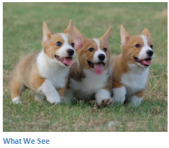
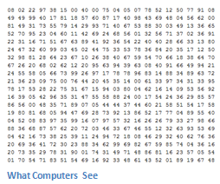
Image Classification
Task of taking an input image and outputting a class
Probability of classes that best describes the image
For humans, effortless task

Slide 25
Input Image
An image is an an array of pixel values
A JPG color image with size 480 x 480:
The representative array will be 480 x 480 x 3. Each number is given a value from 0 to 255 which is the pixel intensity
Grey scale image contains a single sample (intensity value) for each pixel
Image Classification:
Given an array of numbers, produce probabilities of the image being a certain class

Slide 26
Convolutional Neural Networks
Three basic ideas:
Local receptive fields
Shared weights
Pooling

Slide 27
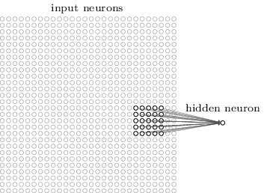
Local Receptive Fields
Connections are from small, localized regions of the input image to hidden layers
A little window on the input pixels
Each neuron in the first hidden layer is connected to a small region of the input neurons. For example, a 5x5 region

Slide 28
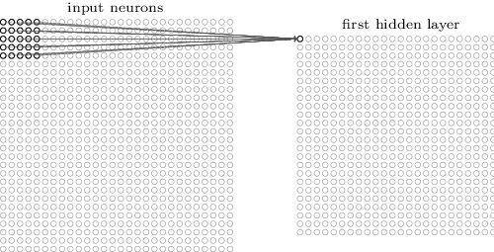
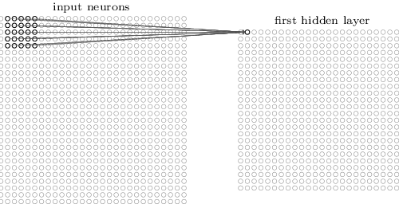
Local Receptive Fields

Slide 29
Convolution
From Goodfellow 2017
Replace matrix multiplication in networks with convolution
The rest (gradient etc…) remains the same
Because of the small kernel, connections are sparse
http://cs231n.github.io/convolutional-networks/

Slide 30
Size, Stride & Padding
A convolution layer takes:
Input volume W₁xH₁xD₁
K number of filters (kernels) of size FxF
A stride or step S
An amount of zero padding P
A convolution layer produces:
Output volume W₂xH₂xD₂
Where:
The d-th W₂xH₂ slice is the conv. of the d-th filter over the input with stride S and d-th bias
W₂=(W₁-F+2P)/S+1
H₂=(H₁-F+2P)/S+1
D₂=K
With weight sharing per filter, it has:
FxFxD₁xK weights
K biases
Common values:
F=3, S=1, P=1
Common Structure:
Input -> [[Conv. -> ReLU]*N -> Pool?]*M -> [FC -> ReLU]*L -> FC
F
S
F
P

Slide 31
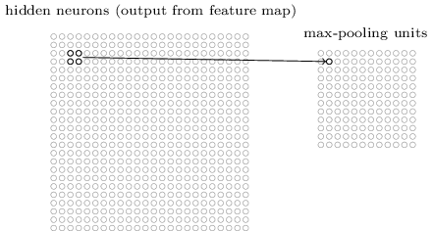
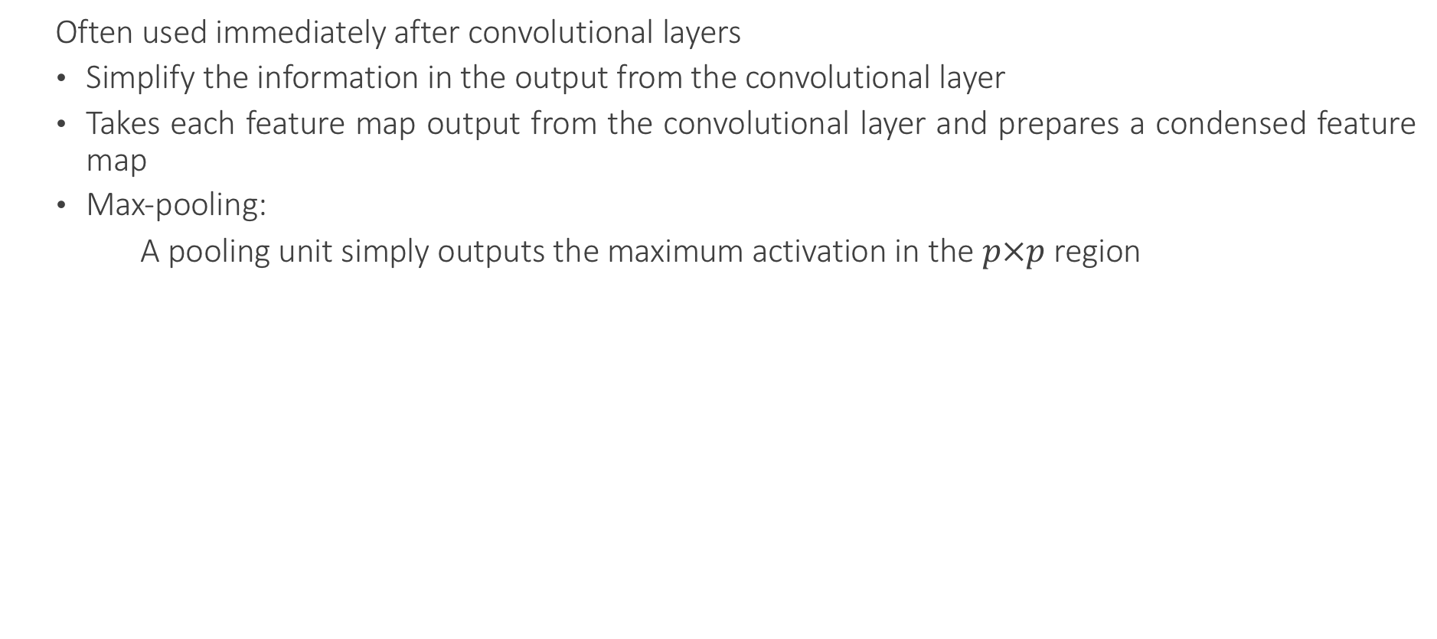
Pooling Layers
Often used immediately after convolutional layers
Simplify the information in the output from the convolutional layer
Takes each feature map output from the convolutional layer and prepares a condensed feature map
Max-pooling:
A pooling unit simply outputs the maximum activation in the $p×p$ region

Slide 32
Max Pooling
Single depth slice
1 | 1 | 2 | 4
5 | 6 | 7 | 8
3 | 2 | 1 | 0
1 | 2 | 3 | 4
x
max pool with 2x2 filters and stride 2
6 | 8
3 | 4
y

Slide 33

Pooling Layers
Smaller representations and more manageable
Operates over each activation map independently

Slide 34
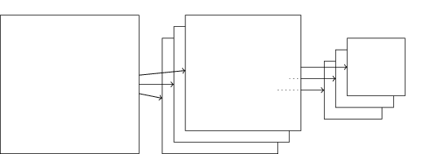
Pooling Layers
Combined convolutional and max-pooling layers:

Slide 35
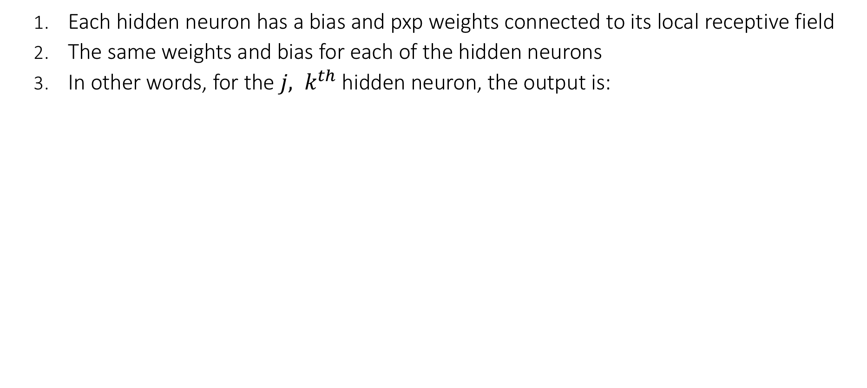
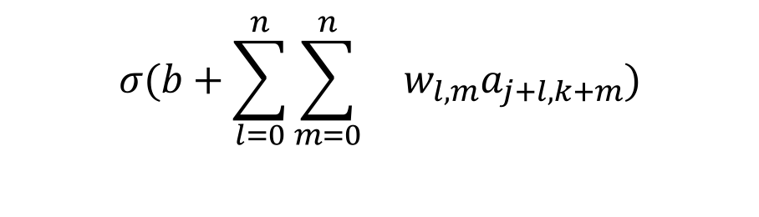
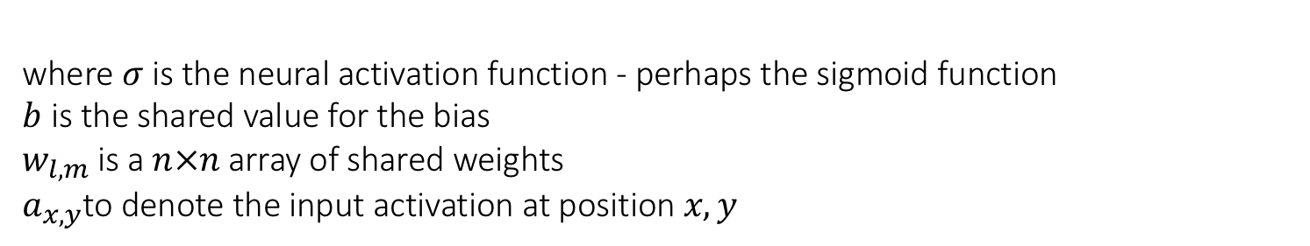
Shared Weights And Biases
Each hidden neuron has a bias and pxp weights connected to its local receptive field
The same weights and bias for each of the hidden neurons
In other words, for the ${j, k}^{th}$ hidden neuron, the output is:
$$σ(b+\sum_{l=0}^{n}{\sum_{m=0}^{n}{ w_{l,m}a_{j+l,k+m})}}$$
where $σ$is the neural activation function - perhaps the sigmoid function
$b$is the shared value for the bias
$w_{l,m}$is a $n×n$array of shared weights $a_{x,y}$to denote the input activation at position $x, y$

Slide 36
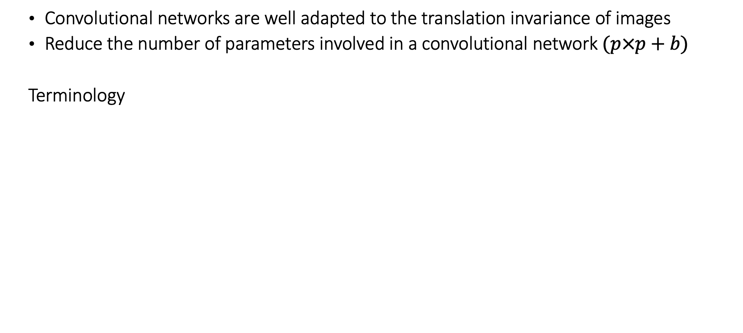
Shared Weights And Biases
Convolutional networks are well adapted to the translation invariance of images
Reduce the number of parameters involved in a convolutional network $(p×p+b)$
Terminology
Feature map/Activation map | Map from the input layer to the hidden layer
Shared weights | Weights defining the feature map
Shared bias | Bias defining the feature map
Kernel/Filter | Shared weights and bias

Slide 37
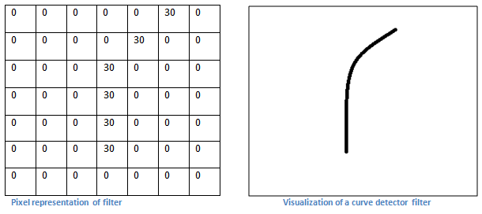
First Layer – High Level Perspective
Filters can be thought of as feature identifiers (straight edges, simple colors, and curves)
In the simple case of a one filter convolution and a curve detector filter, activation map results in regions that are most likely curves in the picture
More filters mean greater the depth of the activation map
This results in more information about the input

Slide 38
Going Deeper Through The Network
Many layers are interspersed between convolution layers (example: ReLu and Dropout)
Introduction of nonlinearities
Improve the robustness of the network and control overfitting

Slide 39

Fully Connected Layer (FC layer)

Slide 40
Deep Learning And NLP

Slide 41
What is NLP
Building computational algorithms to automatically analyze and represent human language.
Applications in: Search Engines, Voice Assistants, machine translation and dialogue generation.
Previously used traditional machine learning models like SVM or logistic regression.
Required time-consuming, hand-crafted features
Linguistic information was represented with sparse representations
Lead to problems such as the curse of dimensionality
Evolution of distributed representations (e.g., word2vec)
Convolutional, recurrent, and recursive neural networks
Unsupervised sentence representation learning

Slide 42

Word Embedding
Mapping of words or phrases to vectors of real numbers
The output is a vocabulary
Word2vec is a set of 2-layer networks that perform the mapping
Continuous Bag of Words (CBOW) networks predict current word from a context of 5 (default) surrounding words. Order is not important
Continuous skip-gram uses the current word to predict the context (10 words by default). Closer words weigh more heavily.
Words that in similar contexts have similar embeddings
The cosine similarity of the vectors is high
Semantic and syntactic relationships can be captured to an extent, e.g. in vector space:
“brother” – “man” + ”woman” ≈ “sister”
skip-gram with Window Size of 2 (4 words)

Slide 43
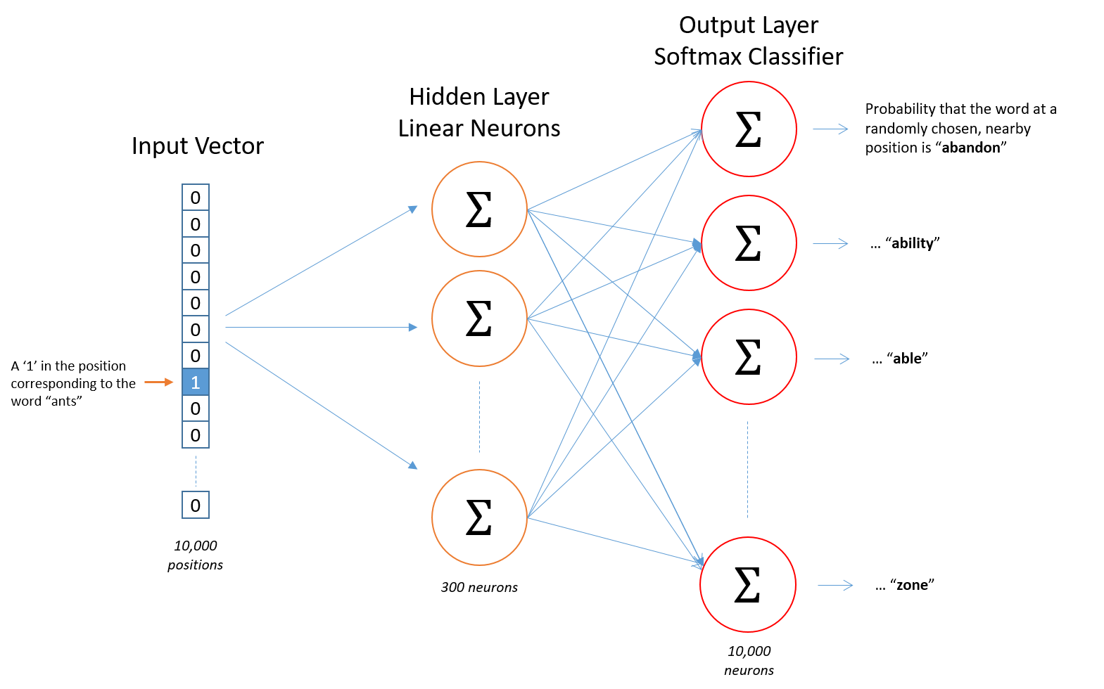
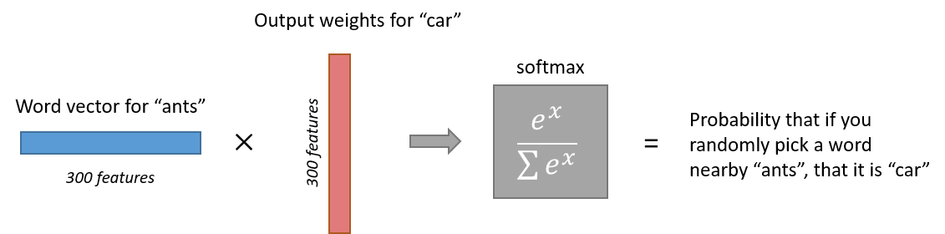
Word Embedding – How does it work?
Example with
10000 Word
Vocabulary
&
300 Features
1 X 300
word vector
Input is 10000 X 1 Vector
1-hot vector: 1 in word position, rest all zeros
Hidden Layer 10000 X300
Acts like a lookup table
Output layer with
10000 neurons
Probabilities generated for
each of 10000 words

Slide 44
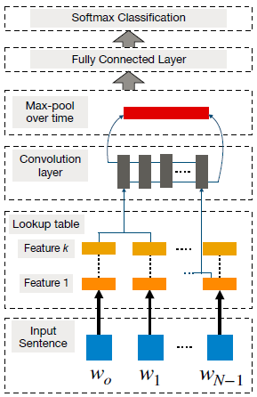
CNNs for NLP
Neural-based approach which represents a feature function that is applied to constituting words or n-grams to extract higher-level features
Has been effectively used for sentiment analysis, machine translation, and question answering, among other tasks
Goal of the method is to transform words into a vector representation via a look-up table, which results in a primitive word embedding approach that learns weights during the training of the network

Slide 45
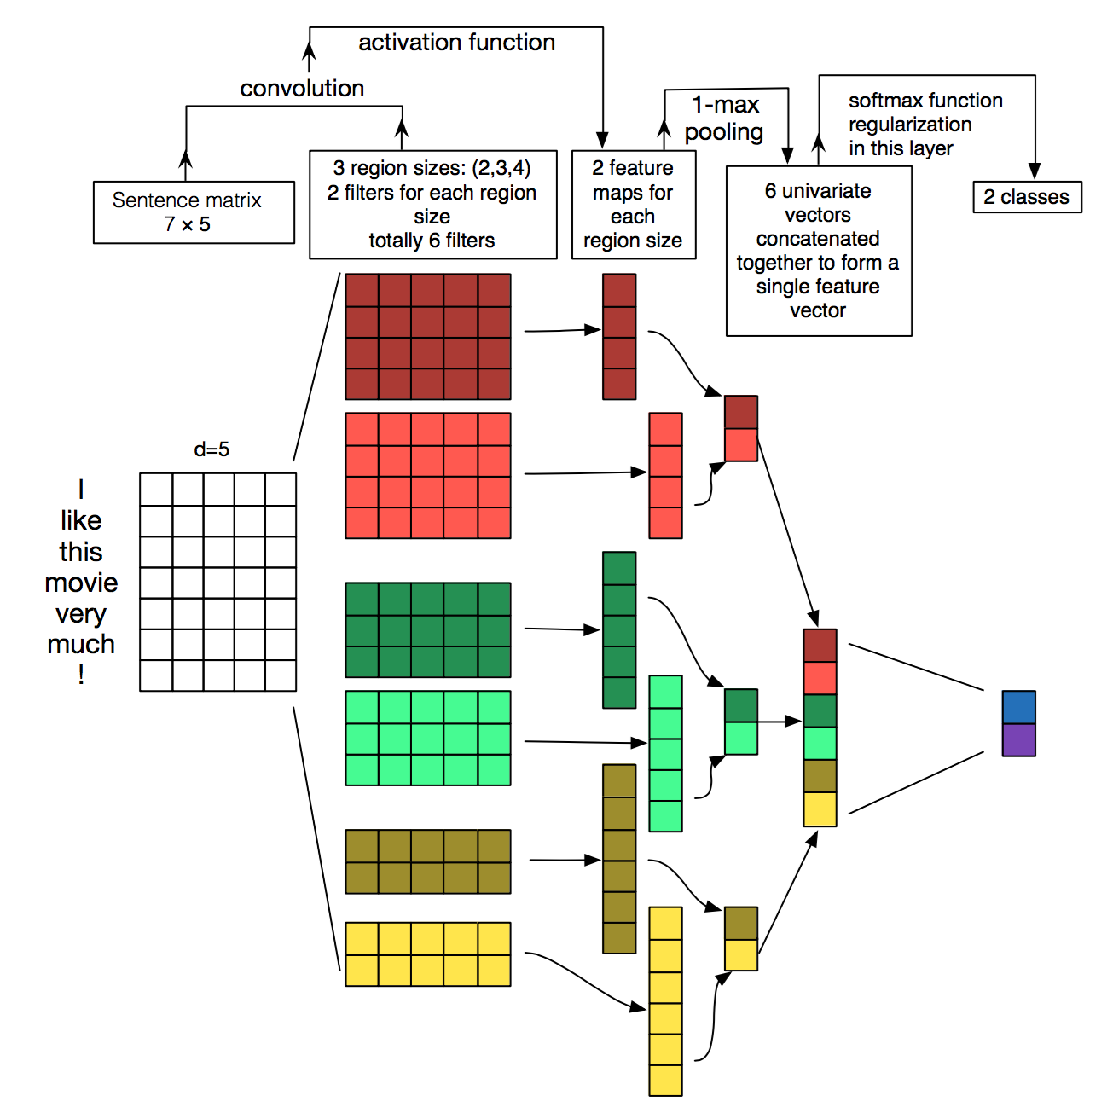
CNNs for NLP
In vision, filters slide over local patches of an image, but in NLP, filters slide over full rows of the matrix (words).
The height, or region size, may vary, but sliding windows over 2-5 words at a time is typical.
Example of Convolutional Neural Network for NLP:

Slide 46
CNNs for NLP
CNNs were responsible for major breakthroughs in Image Classification and are the core of most Computer Vision systems today, from Facebook’s automated photo tagging to self-driving cars.
More recently, CNNs are also applied to problems in Natural Language Processing.
The intuitions behind CNNs are easier to understand for the Computer Vision use case.

Slide 47
CNNs for NLP
Instead of image pixels, the input to most NLP tasks are sentences or documents represented as a matrix.
Each row of the matrix corresponds to one token, typically a word, but it could be a character. That is, each row is vector that represents a word.
Typically, these vectors are word embeddings, but they could also be one-hot vectors that index the word into a vocabulary.
For a 10-word sentence using a 100-dimensional embedding we would have a 10×100 matrix as our input. That’s our “image”.

Slide 48
What about the nice intuitions we had for Computer Vision?
With text, you probably do care a lot where in the sentence a word appears.
Pixels close to each other are likely to be semantically related (part of the same object), but the same isn’t always true for words.
In many languages, parts of phrases could be separated by several other words.
Words compose in many ways: an adjective modifying a noun, but how exactly this works and what higher level representations actually “mean” isn’t as obvious as in the Computer Vision case.

Slide 49
What about the nice intuitions we had for Computer Vision?
Given all this, it seems like CNNs wouldn’t be a good fit for NLP tasks.
Recurrent Neural Networks make more intuitive sense. The are similar to how we process language: Reading sequentially from left to right.
Fortunately, this doesn’t mean that CNNs don’t work.

Slide 50
CNNs work for NLP!
The simple Bag of Words model is an obvious oversimplification and can lead to pretty good results.
A big argument for CNNs is that they are fast. Very fast.
Convolutions are a central part of computer graphics and typically, implemented on GPUs.
Compared to something like n-grams, CNNs are efficient with representation. With a large vocabulary, computing anything more than 3-grams can quickly become expensive.
Even Google doesn’t provide anything beyond 5-grams. Convolutional Filters learn good representations automatically, without needing to represent the whole vocabulary.
Possibly, many of the learned filters in the first layer capture feature similar to n-grams, but represent them in a more compact way.

Slide 51
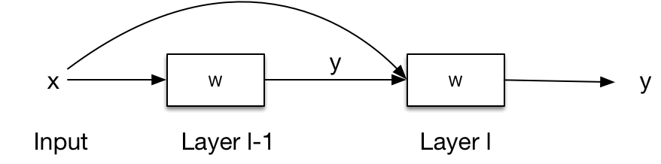
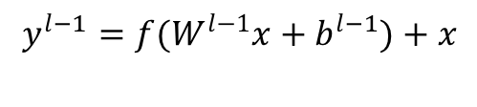
A Special Mention to… Residual Networks
Training accuracy of deep CNNs saturates, then degrades. The larger the network, the larger the error
We introduce “skip” connections and learn the residual function
F(x)=H(x)-x
This is easier to learn
https://arxiv.org/abs/1512.03385
$$y^{l−1}=f(W^{l−1}x+b^{l−1})+x$$

Slide 52
ResNet – Microsoft Research

Slide 53
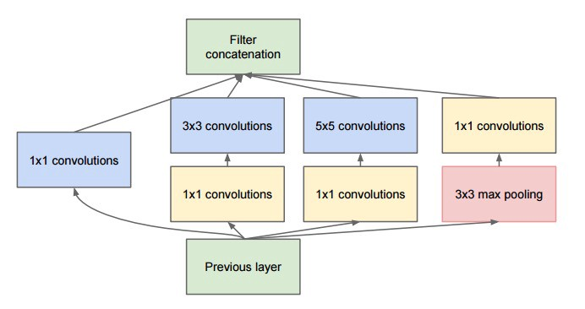
A Special Mention to… Inception Networks
Maximize the information flow by exploiting parallelism
Build “network in network” modules
https://arxiv.org/abs/1409.4842

Slide 54
GoogleNet

